Slide 1

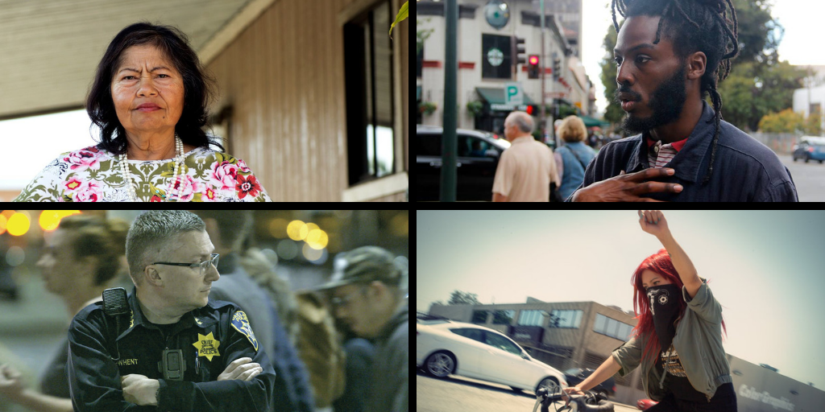
CALIFORNIA DOCUMENTARY PROJECT GRANTS
R&D and Production
November 1, 2019 Deadline
Left to right: No Más Bebés, Romeo is Bleeding, The Force and Ovarian Psycos

Slide 2

California Humanities
California Humanities is an independent non-profit and a state partner of the National Endowment for the Humanities.
Our mission is to connect Californians to ideas and one another in order to understand our shared heritage and diverse cultures, inspire civic participation, and shape our future.
Programs & Initiatives:
• California Documentary Project
• Humanities For All (Quick and Project Grants)
• Library Innovation Lab
• CA 2020: Youth Perspective and the Future of California
• Literature & Medicine
Notes:
JL needs to update

Slide 3
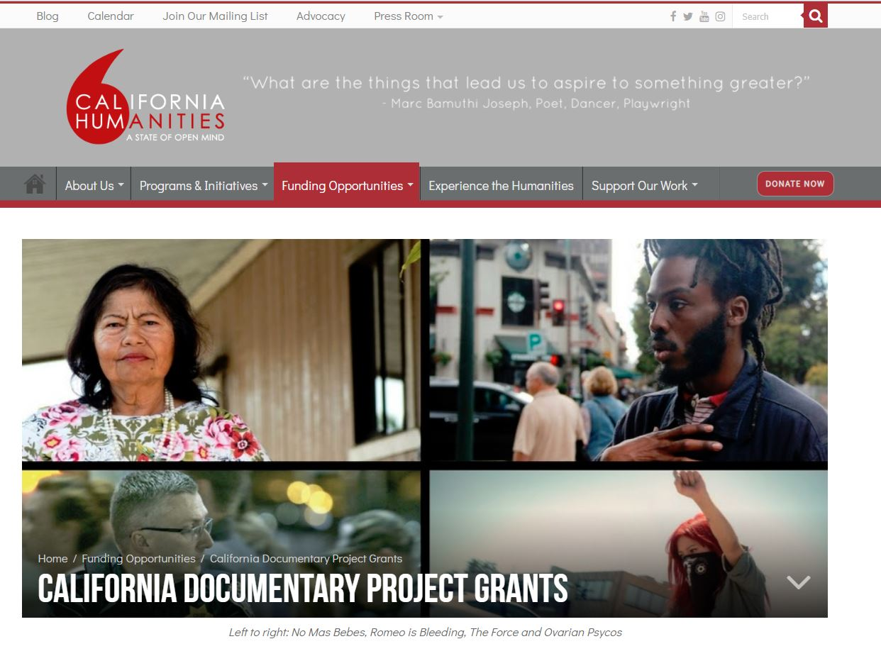

Slide 4
The California Documentary Project (CDP) is a competitive grant program that supports:
  Film, audio, and interactive media projects
  California subjects & issues
  Use the humanities to provide context, depth, and perspective
  Statewide and national audiences
  Shorts, podcasts, web series, features, etc. are all welcome
  Research & Development grants up to $10,000
  Production grants up to $50,000, but may range between
  $20,000 to $50,000
  DEADLINE: November 1, 2019, 5:00 pm

Slide 5
The California Documentary Project (CDP) is a competitive grants program of California Humanities that supports documentary film, radio and new media productions that enhance our understanding of California and its cultures, peoples, and histories. Projects must use the humanities to provide context, depth, and perspective and be suitable for California and national audiences through broadcast and/or distribution.
Grant categories:
  Research & Development: Film, radio and new media up to $10,000
  Production: Up to $50,000, but CDP Production grants may range between $20,000 to $50,000.
DEADLINE: 5:00 pm on October 1, 2013
  Who Can Apply?
  Nonprofit organizations or state and municipal entities (e.g., public universities, libraries, museums)
  Individuals with fiscal sponsorship from a nonprofit entity
  One open grant or proposal under review with California Humanities as project director or applicant organization permitted at any one time, unless an approved multi-application fiscal sponsor
  California residency is not required.

Slide 6
The California Documentary Project (CDP) is a competitive grants program of Cal Humanities that supports documentary film, radio and new media productions that enhance our understanding of California and its cultures, peoples, and histories. Projects must use the humanities to provide context, depth, and perspective and be suitable for California and national audiences through broadcast and/or distribution.
Grant categories:
  Research & Development: Film, radio and new media up to $10,000
  Production: Up to $50,000, but CDP Production grants may range between $20,000 to $50,000.
DEADLINE: 5:00 pm on October 1, 2013
  Project Requirements
  All CDP projects should:
  Be in the production or research & development stage
  Document California subjects and issues
  Use the humanities to provide context, depth, and perspective
  Actively involve humanities advisors
  Have a previously completed work to submit
  Be suitable for California and national audiences

Slide 7
The California Documentary Project (CDP) is a competitive grants program of Cal Humanities that supports documentary film, radio and new media productions that enhance our understanding of California and its cultures, peoples, and histories. Projects must use the humanities to provide context, depth, and perspective and be suitable for California and national audiences through broadcast and/or distribution.
Grant categories:
  Research & Development: Film, radio and new media up to $10,000
  Production: Up to $50,000, but CDP Production grants may range between $20,000 to $50,000.
DEADLINE: 5:00 pm on October 1, 2013
California Documentary Project
  Annual funding statistics R&D and Production:
  211 grants made since 2003 for over $5.5 million
Year | # of Applications | Grants Approved | Amount Requested | Total Grant Allocation | % of Request Funded
2016 | 156 | 15 | $5,258,572 | $391,500 | 7%
2017 | 140 | 14 | $4,519,814 | $400,000 | 9%
2018 | 139 | 14 | $4,679,320 | $302,000* | 6.5%
2019 | 178 | 14 | $6,206,816 | $350,000 | 5.6%

Slide 8

  UNITED SKATES
  By Dyana Winkler and Tina Brown
  CALIFORNIA DOCUMENTARY PROJECT
  Production Grant

Slide 9

LAST DAY OF FREEDOM
By Dee Hibbert-Jones and Nomi Talisman
  CALIFORNIA DOCUMENTARY PROJECT
  R&D and Production Grants

Slide 10


PODCASTS & RADIO
The Stoop www.thestoop.org
By Hana Baba and Leila Day
The Stoop podcast digs into stories that are not always shared out in the open. Hosts Leila Day and Hana Baba start conversations and provide sound-rich stories about what it means to be black, and how we talk about blackness.
California Foodways
By Lisa Morehouse
www.californiafoodways.com
Everybody eats, and food propels storytelling. We go county by county reporting radio (and print) stories about Californians through the lens of food

Slide 11

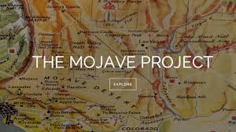
INTERACTIVE/WEB-BASED
K-TOWN ’92 http://ktown92.com/
Dir: Grace Lee
When the LA riots/uprising/civil unrest exploded in 1992, images of destruction beamed across the globe with little context as to why these events had occurred. TV news focused on African Americans, Latinos, and Koreans as both victims and perpetrators of violence, and footage of the “first multicultural riots” locked each group within a stereotype.
The Mojave Project
Dir: Kim Stringfellow
http://mojaveproject.org/
The Mojave Project is a transmedia documentary led by Kim Stringfellow exploring the physical, geological and cultural landscape of the Mojave Desert.

Slide 12
Review Criteria
Applications will be evaluated using the following criteria:
  Quality
      Clarity and strength of concept, style and approach
      Access and relationship of project team to subject/s
      California and national relevance
      Depth of humanities content and approach
      Experience of project staff and advisors
      Strength of work-in-progress /sample work
      Significance of project goals and impact
  Capacity
      Feasibility of budget, timeline, fundraising
      strategy, outreach and evaluation

Slide 13
The California Documentary Project (CDP) is a competitive grants program of Cal Humanities that supports documentary film, radio and new media productions that enhance our understanding of California and its cultures, peoples, and histories. Projects must use the humanities to provide context, depth, and perspective and be suitable for California and national audiences through broadcast and/or distribution.
Grant categories:
  Research & Development: Film, radio and new media up to $10,000
  Production: Up to $50,000, but CDP Production grants may range between $20,000 to $50,000.
DEADLINE: 5:00 pm on October 1, 2013
General Advice
  California Humanities often supports projects’ earliest stages
  Importance of the proposal
  Be succinct but don’t skimp on details
  Anticipate and minimize possible questions
  Leave adequate time to complete application
  Do not try to shoehorn your project to fit CDP, but…
  Feel free to contact us with questions

Slide 14

  What Happens Next?
  Review Process
  Multi-stage review: peer, board and staff participation
  Approximately 4 months
  Notification and Awards
  If funded:
    Grant agreements and disbursement schedule
  If declined:
    Options for obtaining reviewer comments
    Revised applications welcomed

Slide 15
The California Documentary Project (CDP) is a competitive grants program of Cal Humanities that supports documentary film, radio and new media productions that enhance our understanding of California and its cultures, peoples, and histories. Projects must use the humanities to provide context, depth, and perspective and be suitable for California and national audiences through broadcast and/or distribution.
Grant categories:
  Research & Development: Film, radio and new media up to $10,000
  Production: Up to $50,000, but CDP Production grants may range between $20,000 to $50,000.
DEADLINE: 5:00 pm on October 1, 2013
Questions?
  Questions about eligibility, grant guidelines or the
  CDP grant program in general?
  John Lightfoot, Senior Program Officer
  jlightfoot@calhum.org
  Technical questions about the online application process and reporting requirements?
  Debra White, Grants Manager
  dwhite@calhum.org
  Thank you and good luck!

Slide 16
2019 CALIFORNIA DOCUMENTARY PROJECT

